Slide 1
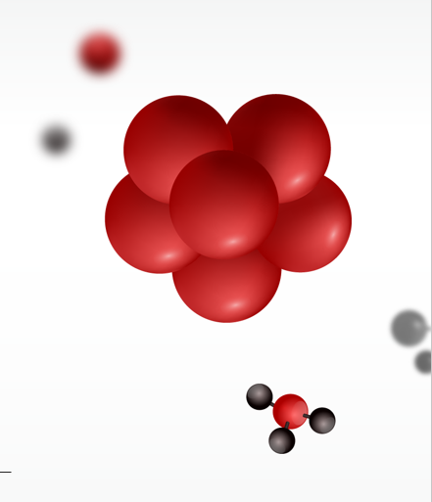
PRINCIPAL COMPONENT ANALYSIS AND QSAR MODELING OF SELECTED LIGAND AGAINST PROSTATE CANCER PROTEIN TARGET
A Research Report in partial fulfilment of the requirement for the course:
Topological and Geometric Data Reduction and Visualization (CSIC 5011)
Presented by:
STUDENT | SID
ADELEKE MARADESA | 20724523
OGEDENGBE IKEOLUWA | 20724157
c/o: Prof. Yuan Yao
May 21st, 2021

Slide 2
Outline
Introduction
Research Objectives
Significance of Study
Data Collection
Descriptive analysis: PCA and t-SNE
Determination of Bioactivity: IC50 determination
Quantitative Structure-activity Relationship (QSAR) Modelling
Molecular Docking
Results and Discussion

Slide 3
Introduction
Bioinformatics
Mathematics
Statistics
Computing
Figure 1: Branches of Bioinformatics

Slide 4
Introduction
Computer Aided Drug Discovery (CADD)
Dissolvability
Bioactivity (binding affinity)
Ligand-receptor interaction
Drug-drug interaction
Figure 2: Scope of CADD

Slide 5
Introduction
Novel
Molecules
Cost Reduction
Reduce ambiguity
Benefits of CADD
Fast track trials
Figure 3: Benefits of CADD

Slide 6
Objectives of Study
Analyze potential drug candidates for the treatment of prostate cancer
Prune the candidate space using the data reduction computational elements of PCA and t-SNE (using the IC50 values)
Conduct QSAR modeling studies on the candidates with acceptable IC50 values above the set threshold
Conduct ligand-protein docking of the active drugs on prostate cancer protein pair.
Based on objectives (iii) and (iv) above, explain the respective properties that characterize the interaction of the candidate (active) molecules and the cancer protein.

Slide 7
Significance of Study
The Data
Prostate cancer is the second most common type of cancer in men
Once it metastasizes, the 5-year survival rate reduces drastically to 30%, compared to about 98% when it hasn't metastasized
Insightful research in this area (which is what we hope this is) will go a long way in contributing significantly to the safe remediation therapies for this unpleasant scourge among men.
Our Proposition

Slide 8
Data Collection/Description
Programming Language | Python
Package used | RDKit
Repository scraped | ChembL
Target Protein | Prostate Cancer
Number of Ligands | 29
Molecular Descriptors | Predictors: Molecular Weight (MW) Octanol Water Partition (LogP) Hydrogen Bond Donor (HBD) Hydrogen Bond Acceptor (HBA) Number of Rotatable Bonds (RTB) Response/Target: Inhibitory concentration (IC50)

Slide 9
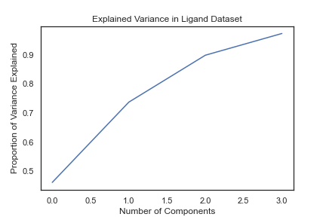
Descriptive Analysis: PCA
Objective: Identify principal components that make the highest contribution to the statistical variance of the descriptors
Figure 4: PCA Results
90% of variations can be explained by 2 components

Slide 10
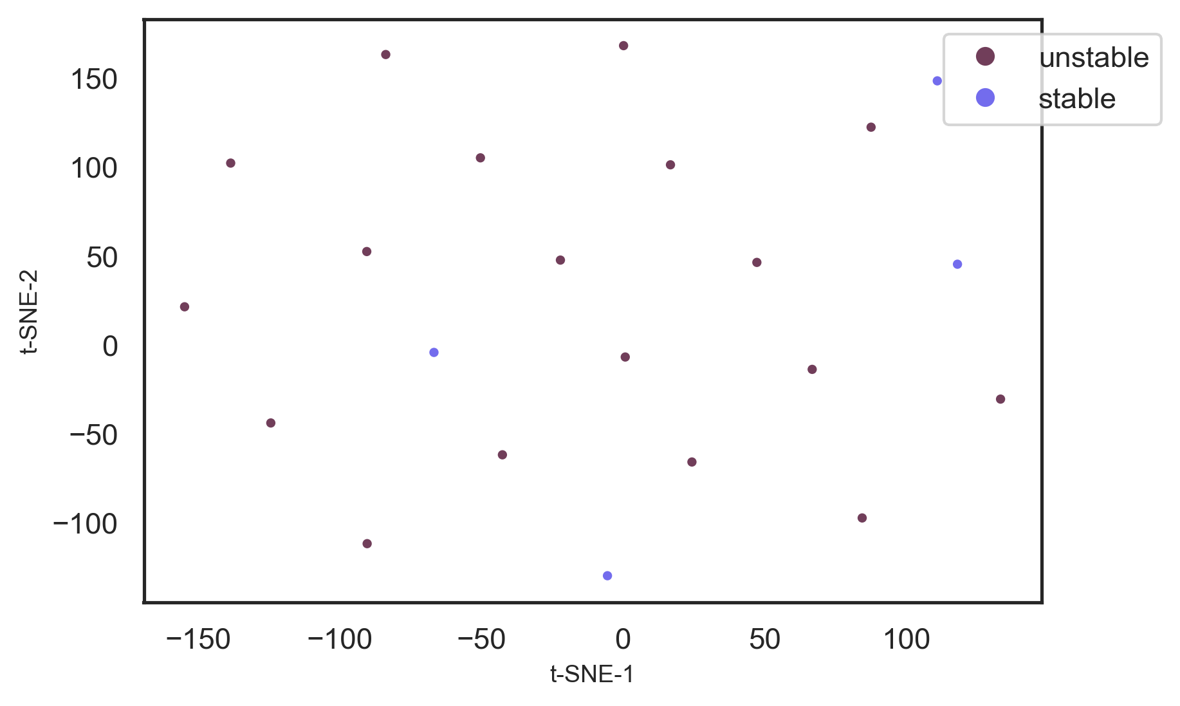
Descriptive Analysis: t-SNE
Figure 5: t-SNE Results
Isolation of stable molecules vis-à-vis unstable ones

Slide 11
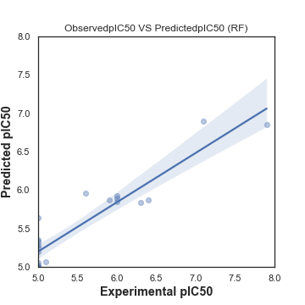
Quantitative Structure-Activity Relationship Modeling (QSAR): Random Forest
Objective: Relationship between molecular descriptors and inhibitory concentration (IC50)
Figure 6: QSAR Results
Random Forest Regression (MSE = 5%; R² = 80.2%)

Slide 12
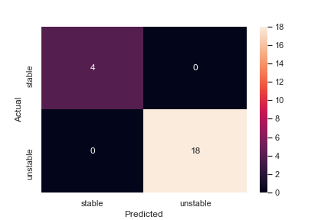
Quantitative Structure-Activity Relationship Modeling (QSAR): Logistic Regression
Objective: Relationship between molecular descriptors and inhibitory concentration (IC50)
Figure 6: QSAR Results
Logistic Regression: Confusion Matrix (Accuracy = 100%)

Slide 13
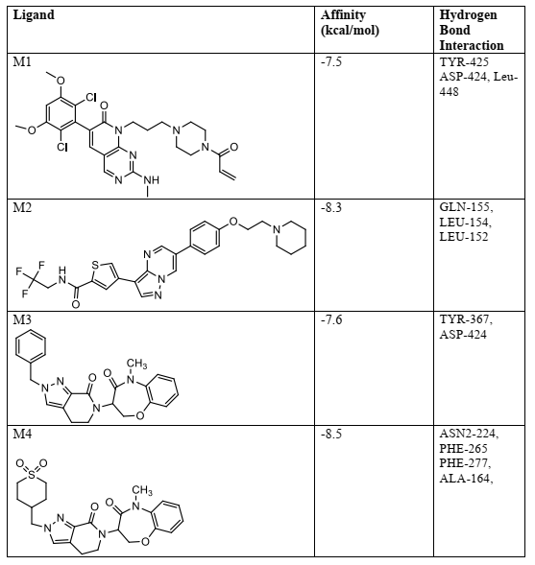
Molecular Docking
Active compounds (Candidates for docking and their respective docking outputs)

Slide 14
Molecular Docking
Docking Parameters
Software | PYRX
Docking modes | 9
Indicators | Binding affinity Hydrogen bond interaction (for SBDD)
Best drug candidates (recommended for clinical trials) | M4 M2

Slide 15
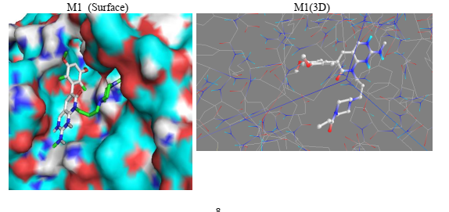
Molecular Docking
Visualization of docking results: Surface and 3D representations
Figure 7: Docking Results for M1

Slide 16
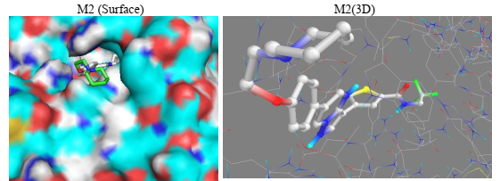
Molecular Docking
Visualization of docking results: Surface and 3D representations
Figure 8: Docking Results for M2

Slide 17
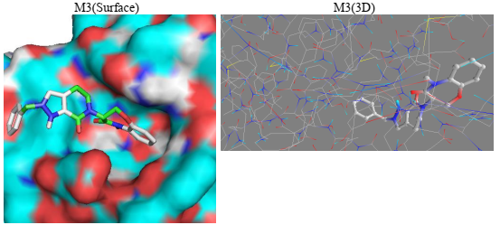
Molecular Docking
Visualization of docking results: Surface and 3D representations
Figure 9: Docking Results for M3

Slide 18
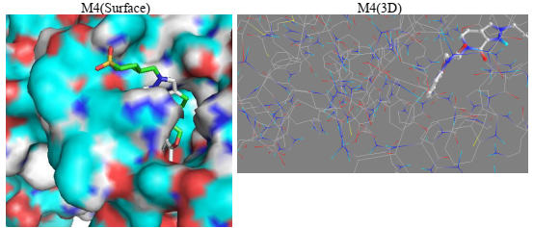
Molecular Docking
Visualization of docking results: Surface and 3D representations
Figure 10: Docking Results for M4

Slide 19
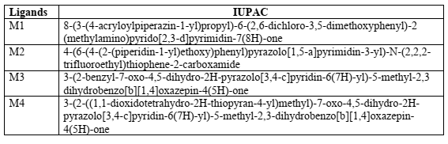
Appendix
Active ligands

